Slide 1
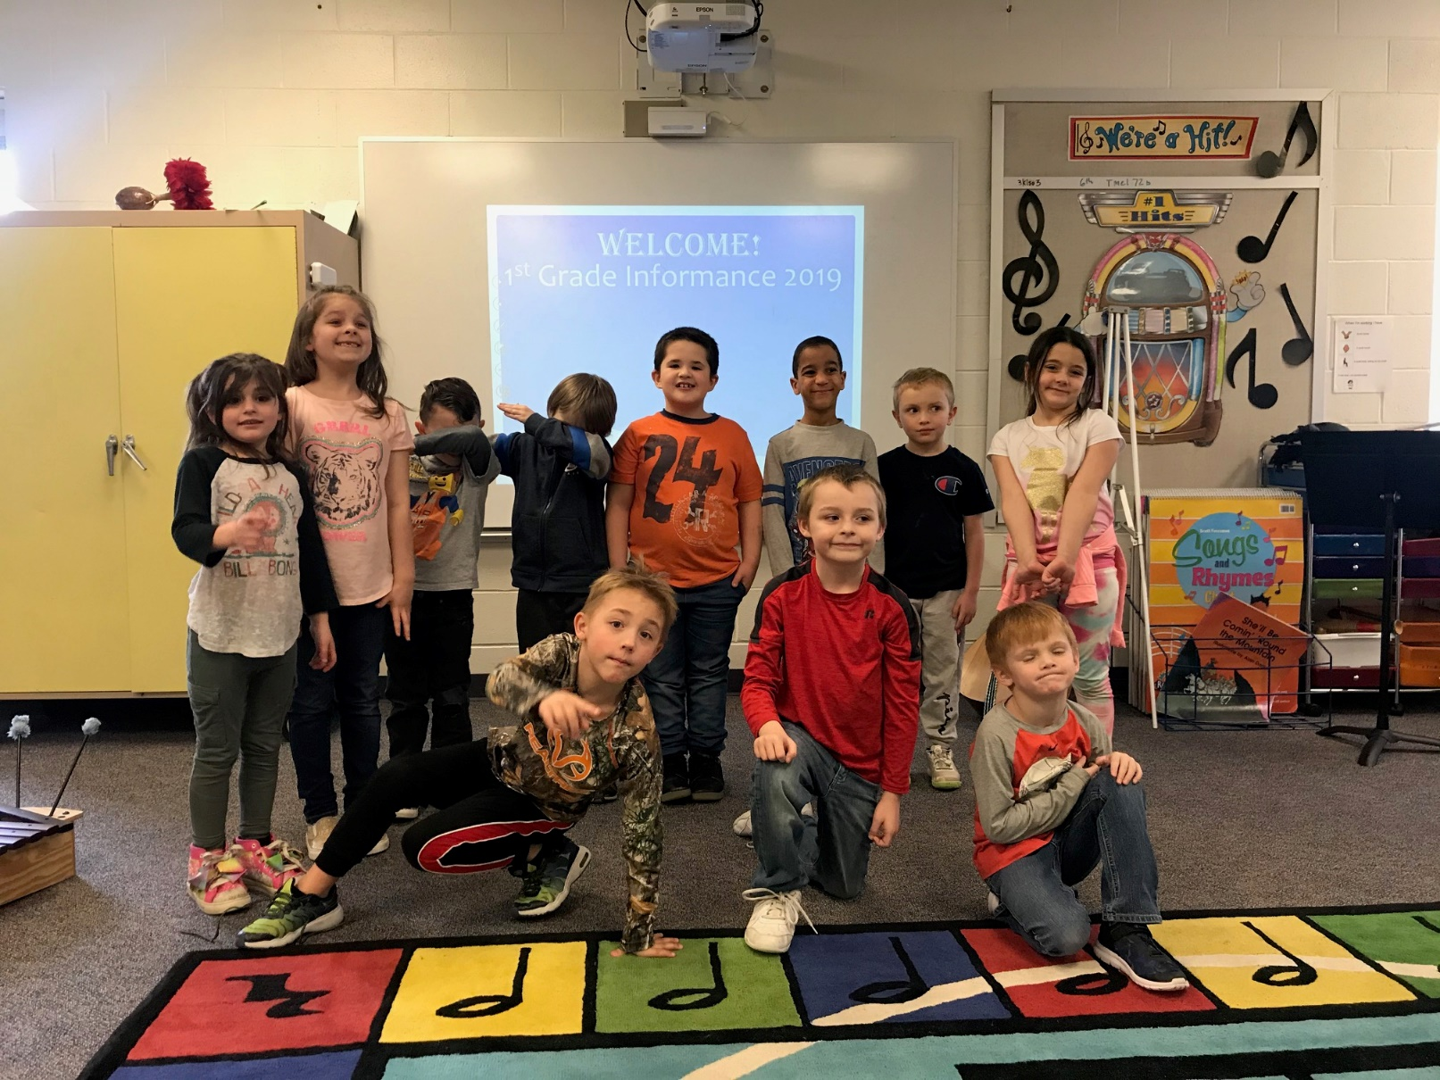
Welcome!
1st Grade Informance 2019

Slide 2
Music Goals for 1st Grade:
Matching pitches in a simple melody (so, la, mi)
Recognizing contrasts: high/low, long/short
Appropriate playing of classroom instruments
Using movement to show musical contour and change
Improvisation on known musical elements
Learning a large variety of musical styles and genres

Slide 3
“Buenos Dias”
“Buenos dias, se como esta?
Ah, muy bien, gracias, y como te va?”
Begin class with a greeting
Understanding foreign language
Identify a steady beat in music

Slide 4
“Down by the Bay”
Focus on form in music
Call and Response; “echo”
Developing leadership skills
Developing listening skills

Slide 5
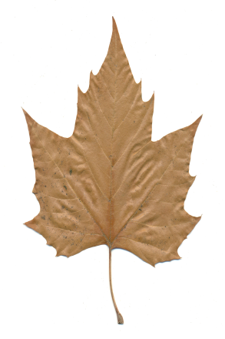
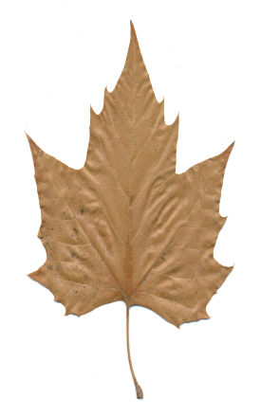
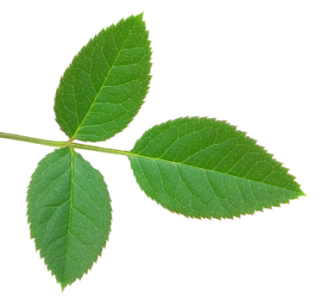
“Leaves”
“All the leaves are falling down, falling gently to the ground. Now the wind will lift them high; lift them gently to the sky.”
Focus on melodic direction, high to low
Using movements to show upward and downward in melody
Discuss four seasons and seasonal changes

Slide 6
“Here Comes Valerie”
Game song
Focus on similar and different melodic patterns
Development of Improvising and copying movements
Development of reacting to changes in music

Slide 7
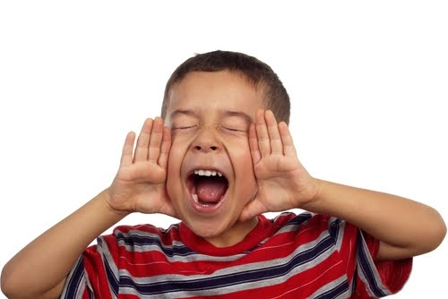
“Sing, Speak, Whisper, Shout”
Focus on voice changes: singing, speaking, whispering, and shouting
Timbre: how each voice has its own unique effects while performing a poem.
Initiation of stage presence

Slide 8
“Shine, Shine, Shine”
Focus on opposites (morning / night, etc.)
More call and response
Developing leadership skills
Developing listening skills
Taking turns soloing in a song.

Slide 9
“Freight Train”

Slide 10
“Rique Ran”

Slide 11
Bee Bee Bumblebee

Slide 12
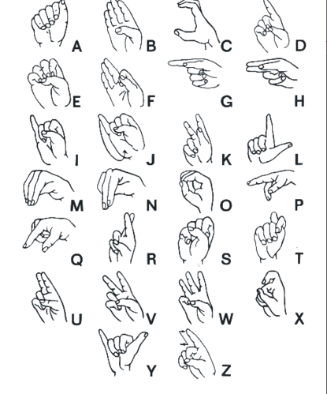
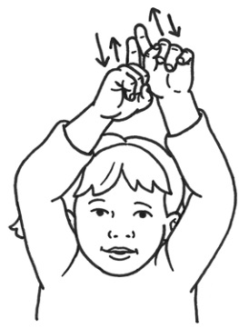
“Great Big Stars”
Focus on American Sign Language
Pitches above the normal register

Slide 13
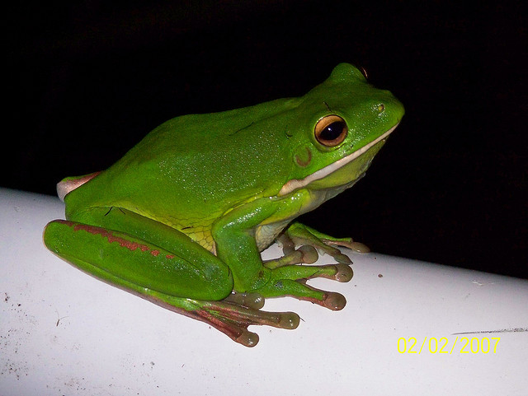
“The Little Green Frog”
Focus melody, low to high
Classroom instrument familiarization
Developing keyboard, listening skills
Reacting to parts of a song
Discuss frogs and their life stages

Slide 14
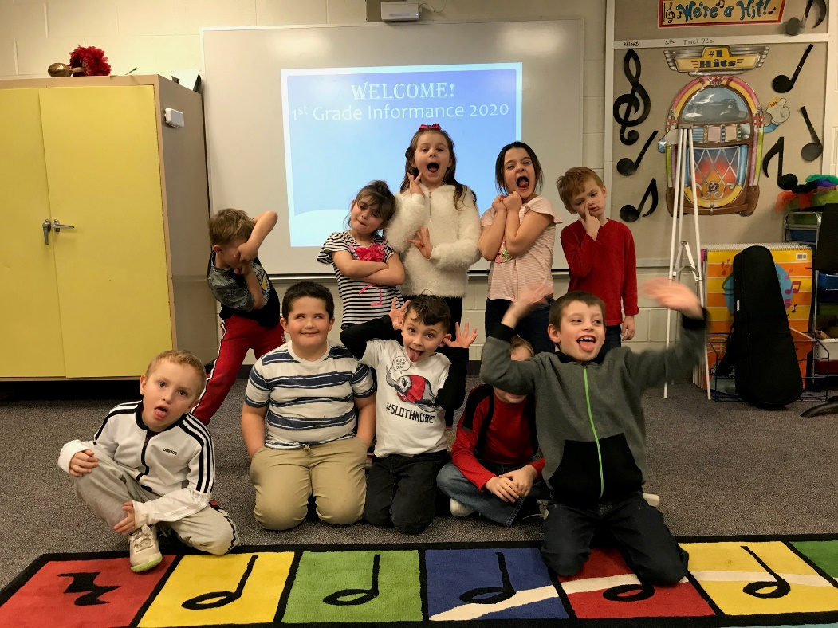
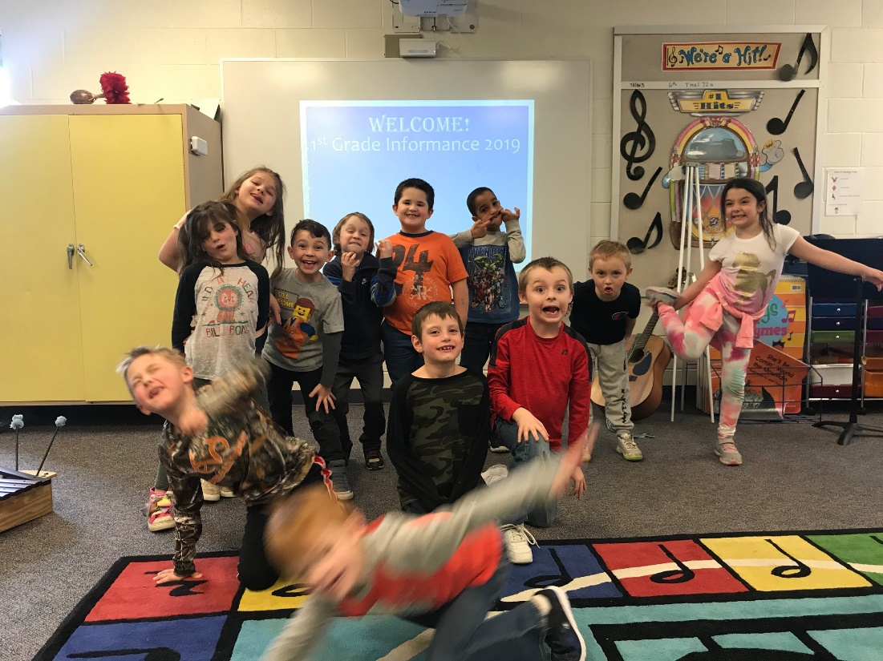
Thank you for coming today!
See you again soon!

Slide 15
Charlie Over the Water
Focus on steady beat
Pitches sol-mi

